Slide 1


CSCE 5640 Operating System Design Threads & Concurrency
Dr. Amar Maharjan
Computer Science and Engineering
University of North Texas
Slides (with some modifications) from:
Operating System Concepts – Silberschatz, Galvin and Gagne © 2018
Notes:
The main thing is how to run parallelly.

Slide 2
Outline
Overview
Multicore Programming
Multithreading Models
Thread Libraries
Implicit Threading
Threading Issues
Operating System Examples
Notes:
Implicit: Automatically done

Slide 3
Overview
A thread is a basic unit of CPU utilization
A traditional process has a single thread of control
Most modern applications are multithreaded
Threads run within application
Multiple tasks with the application can be implemented by separate threads
Update display
Fetch data
Spell checking
Answer a network request
Process creation is heavy-weight while thread creation is light-weight
Can simplify code, increase efficiency
Kernels are generally multithreaded
Notes:
Switching between processes is complex in OS.
All threads in a single process can access data in that process.

Slide 4
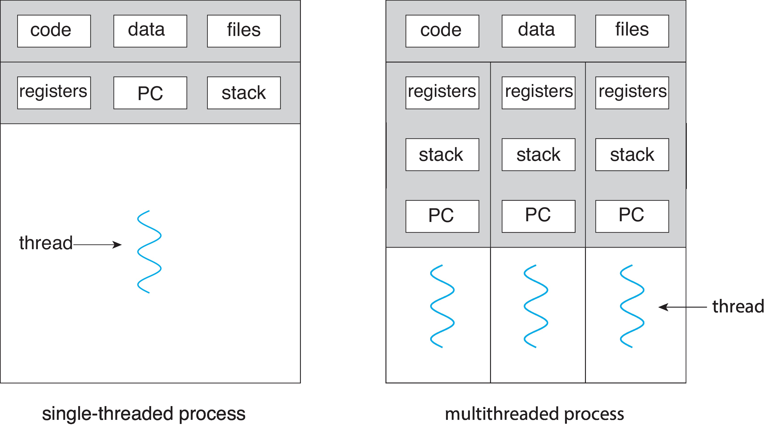
Single and Multithreaded Processes

Slide 5
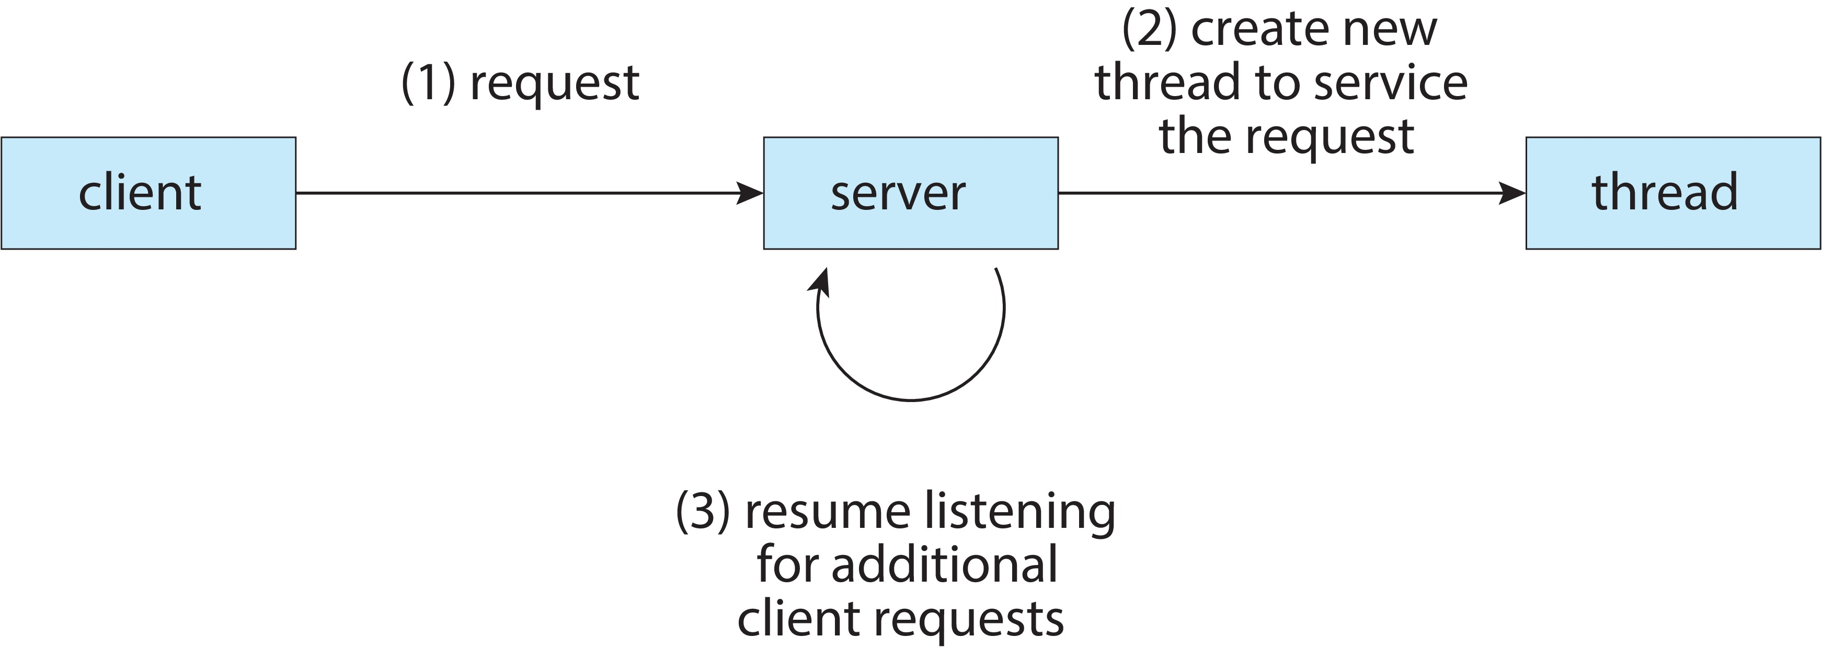
Multithreaded Server Architecture
Notes:
Only 1 server and multiple threads.

Slide 6
Benefits
Responsiveness – may allow continued execution if part of process is blocked, especially important for user interfaces
Resource Sharing – threads share resources of process, easier than shared memory or message passing
Economy – cheaper than process creation, thread switching lower overhead than context switching
Scalability – process can take advantage of multicore architectures
Notes:
Sharing a message between threads, the message can be stored globally, and it can be used. We don’t need any complex tasks like creating a shared memory and all.
Multicore architecture: Use multiple threads in different cores available.

Slide 7
Multicore Programming
Earlier design – single-CPU systems.
Later evolved into multi-CPU systems and multi-core systems.
Concurrency supports more than one task making progress
Single processor / core, scheduler providing concurrency
Parallelism implies a system can perform more than one task simultaneously
Notes:
Parallelism: Executing multiple tasks simultaneously.

Slide 8
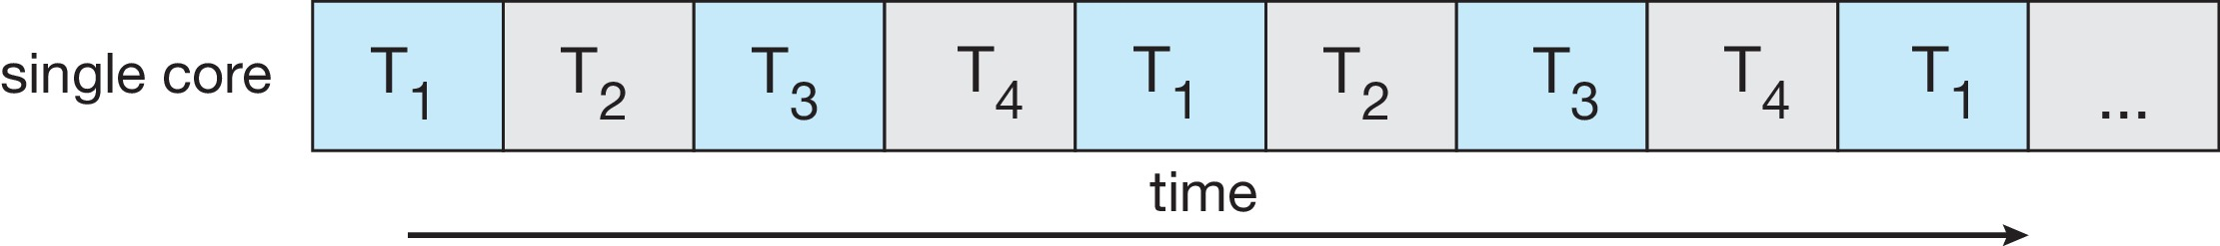
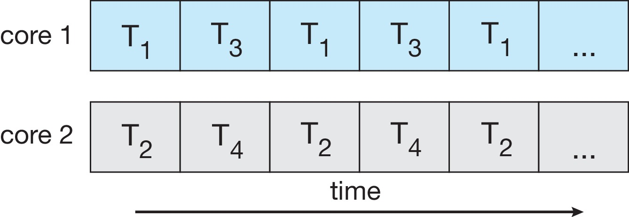
Concurrency vs. Parallelism
Concurrent execution on single-core system:
Parallelism on a multi-core system:
Notes:
They both are different.

Slide 9
Multicore Programming Challenges
Multicore or multiprocessor systems puts pressure on programmers, challenges include:
Identifying tasks
Find areas that can be divided into separate, concurrent tasks.
Balance
Ensuring that the tasks perform equal work of equal value. Some tasks may not be worth to run in separate core.
Data splitting
Data accessed and manipulated by the tasks must be divided to run on multiple cores.
Data dependency
Dependencies between two or more tasks – synchronization needed.
Testing and debugging
Many different execution paths are possible so more difficult to test and debug.
Notes:
Identifying tasks: Which part of the program can be executed parallelly?
Balance: What about the data? Should we split? Check the data dependency.
Testing and debugging: It's more complex and difficult. Because there are multiple threads running, we don’t know this takes which thread has executed.

Slide 10
Types of Parallelism
Two types of parallelism:
Data parallelism
Distributes subsets of the same data across multiple cores, same operation on each core.
Example: Consider summing the contents of an array of size N.
On a single-core system – simply sum the elements [0] …[N-1].
On a dual-core system – Core 0 (thread A: sum of elements [0] …[N/2 -1]), Core 1 (thread B: sum of elements [N/2 …[N-1]).
Task parallelism
Distributing threads across cores, each thread performing unique operation.
Different threads may be operating on the same data, or different data.
Notes:
Data Parallelism: Dividing data into multiple cores.
Task Parallelism
Each core will be executing separate logic.
Ex: 1 core: Total sum of section-1 of Homework-1; 2nd core: Avg of the score of Homework-1

Slide 11
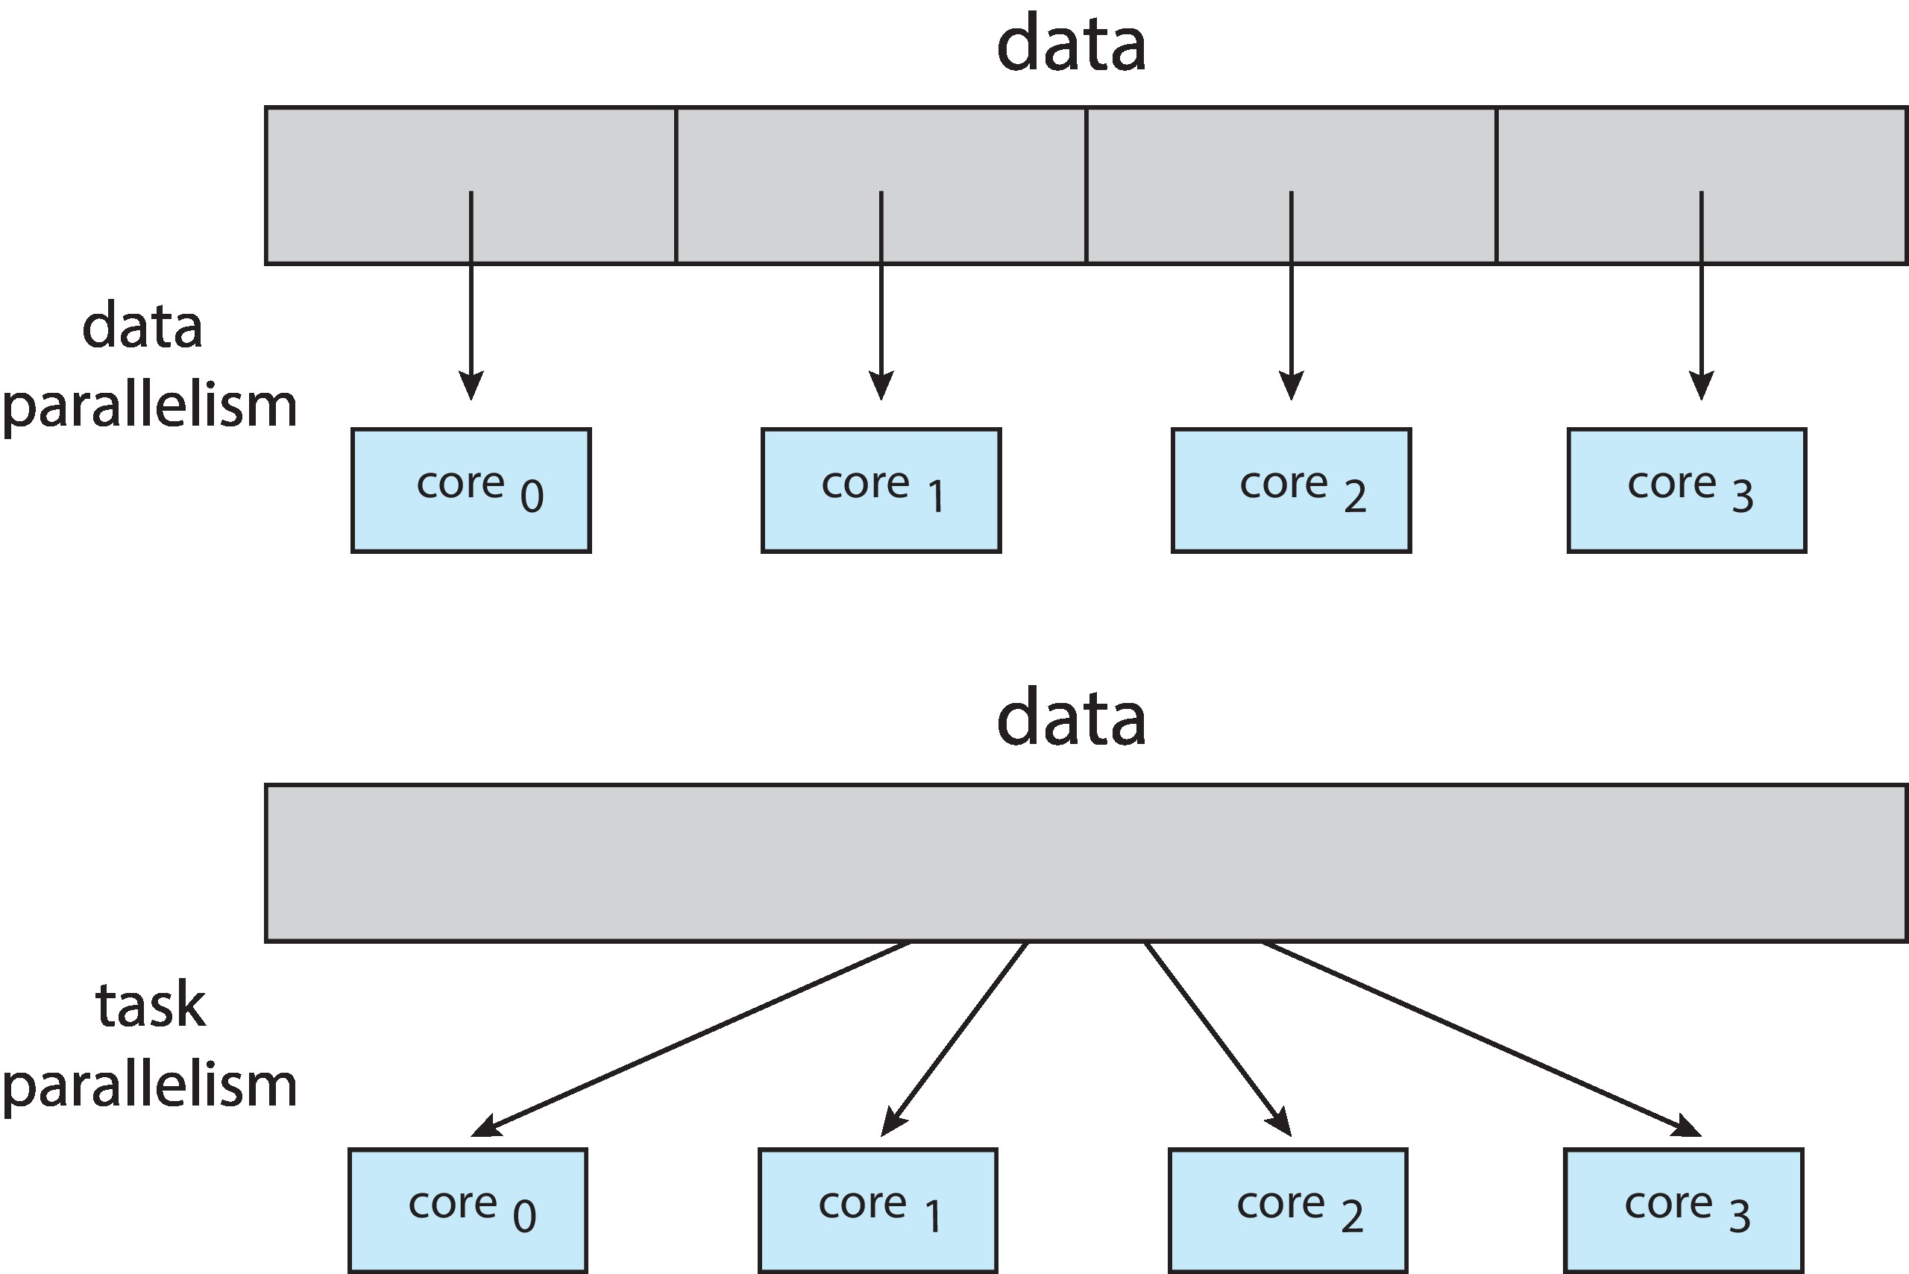
Data and Task Parallelism

Slide 12
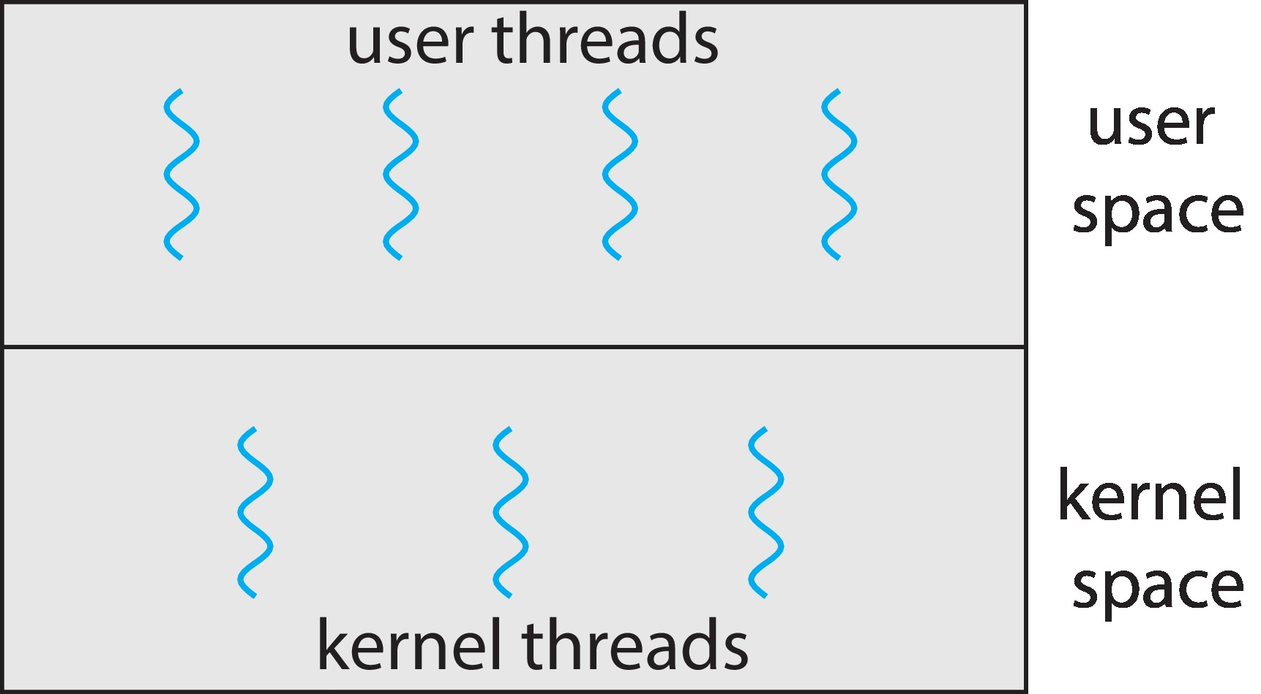
Multithreading Models
User threads - management done by user-level threads library
Three primary thread libraries:
POSIX Pthreads, Windows threads, Java threads
Kernel threads - Supported by the Kernel
Examples – virtually all general-purpose operating systems, including:
Windows, Linux, Mac OS X, iOS, Android
Types of models:
Many-to-One
One-to-One
Many-to-Many
Notes:
POSIX threads; Unix and Mac
Windows thread: In Windows process.
How can we map the user thread into the kernel thread? – Using different models

Slide 13
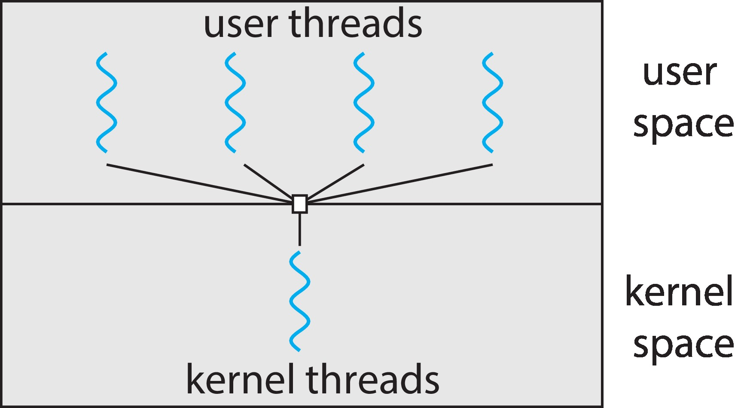
Many-to-One Model
Many user-level threads mapped to single kernel thread
One thread blocking causes all to block
Multiple threads may not run in parallel on multicore system because only one may be in kernel at a time
Few systems currently use this model
Example:
Solaris systems thread library - Green Threads
Notes:
Drawback: If one thread is blocking, we cannot switch to another thread.
Recent OS does not implement the May-to-One model

Slide 14
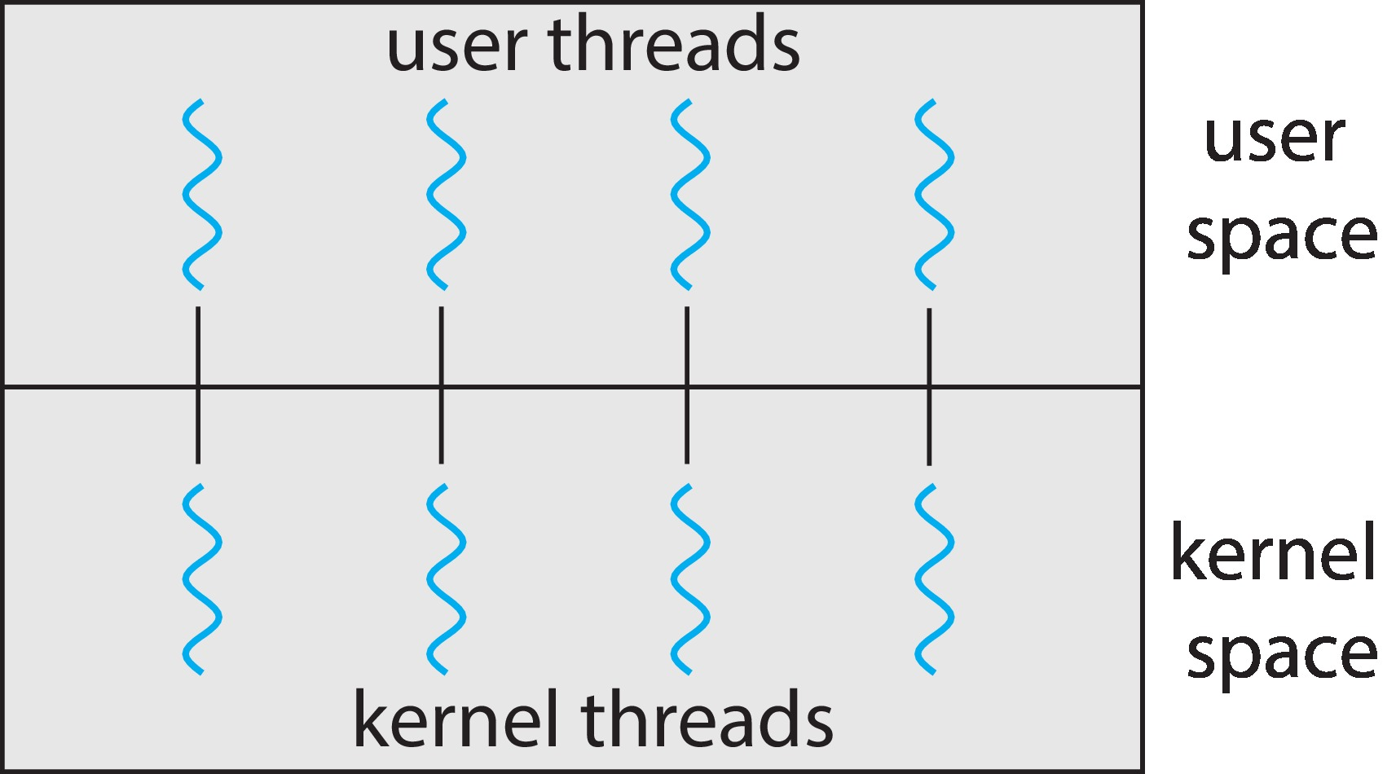
One-to-One Model
Each user-level thread maps to kernel thread
Creating a user-level thread creates a kernel thread
More concurrency than many-to-one
Drawback – many kernel threads may burden the performance of a system.
Examples
Windows
Linux
Notes:
Every time you create a new thread, there is a thread in kernel space.
Windows and Linux are this nowadays.

Slide 15
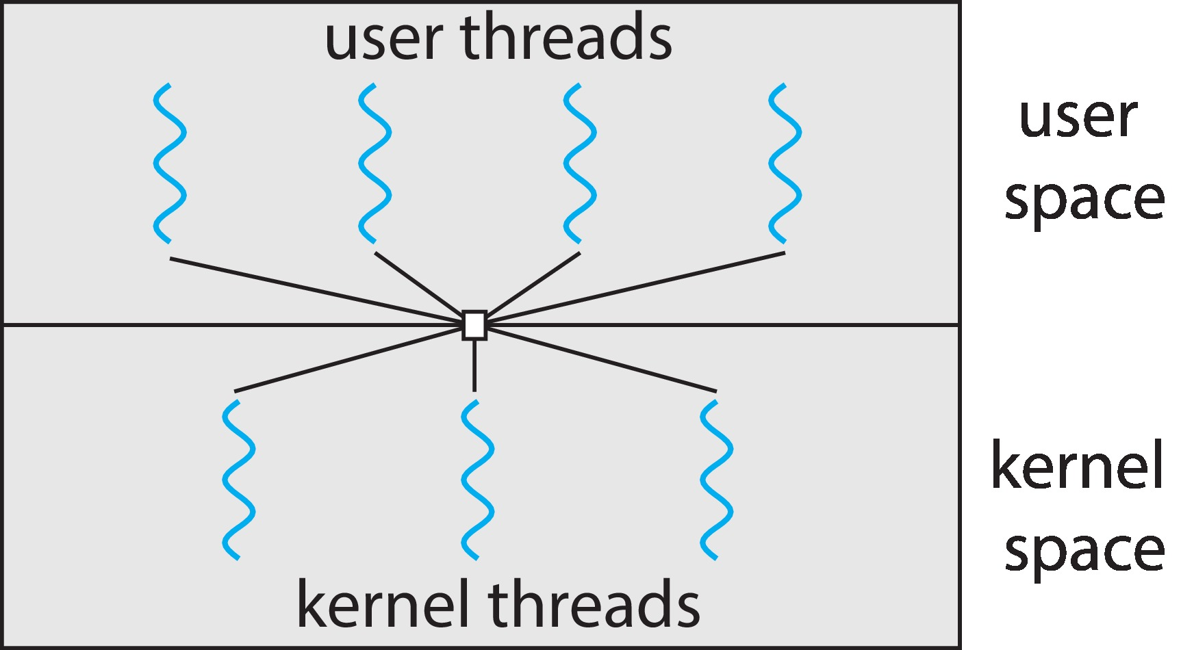
Many-to-Many Model
Allows many user level threads to be mapped to a smaller or equal number of kernel threads
Allows the operating system to create a sufficient number of kernel threads
When a thread performs a blocking system call, the kernel can schedule another thread for execution.
Notes:
It's kind of Hybrid.
Benefits: Reuse the thread instead of creating a new thread every time.

Slide 16
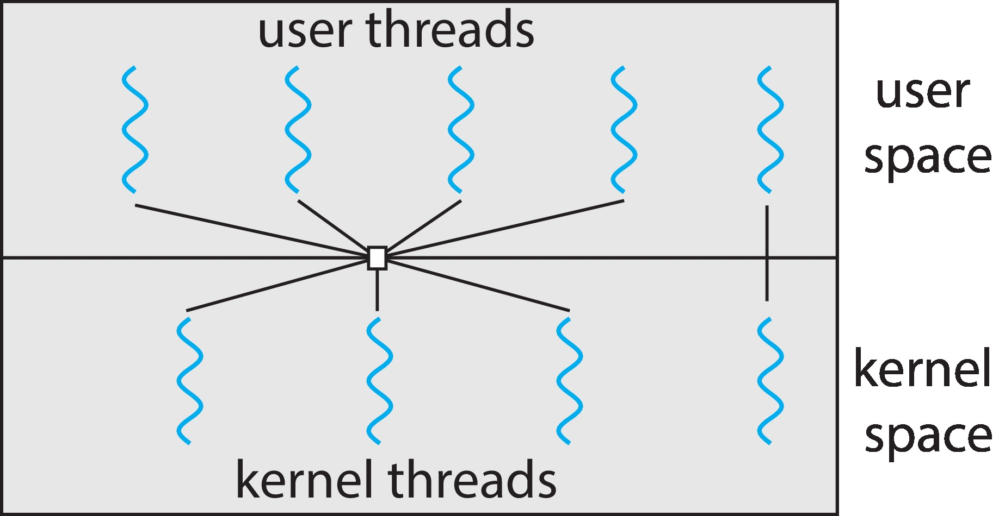
Two-level Model
Similar to Many-to-Many, but it allows a user thread to be bound to a kernel thread

Slide 17
Thread Libraries
A thread library provides programmer with API for creating and managing threads
Two primary ways of implementing
Library entirely in user space
Kernel-level library supported by the OS
Three main thread libraries
POSIX Pthreads – either as user-level or a kernel-level library
Windows – kernel-level library
Java – usually implemented using a thread library available on the host system
Notes:
We use it because most of the complex operations are implemented in these libraries.
Ex: Creating a thread.
PSIX Pthread: This is just a specification.

Slide 18
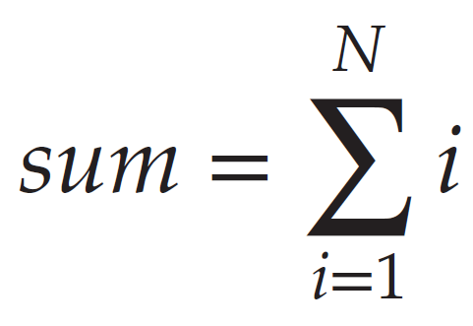
Example: Summation of a Non-Negative Integer
An illustrative example – design a multi-threaded program that performs the summation of a non-negative integer in a separate thread
Two general strategies for creating multiple threads
Asynchronous threading
Parent and child thread execute concurrently and independently
Synchronous threading
Parent waits for all child threads to terminate and join
All of our remaining examples use synchronous threading.
Notes:
N: Take it from the user, maybe the command prompt.
Synchronous threading: The parent thread will wait for the child thread to complete.
Ex: Parent creates a child thread, child thread will compute the sum and give the value to the parent, and the parent will return the result.

Slide 19
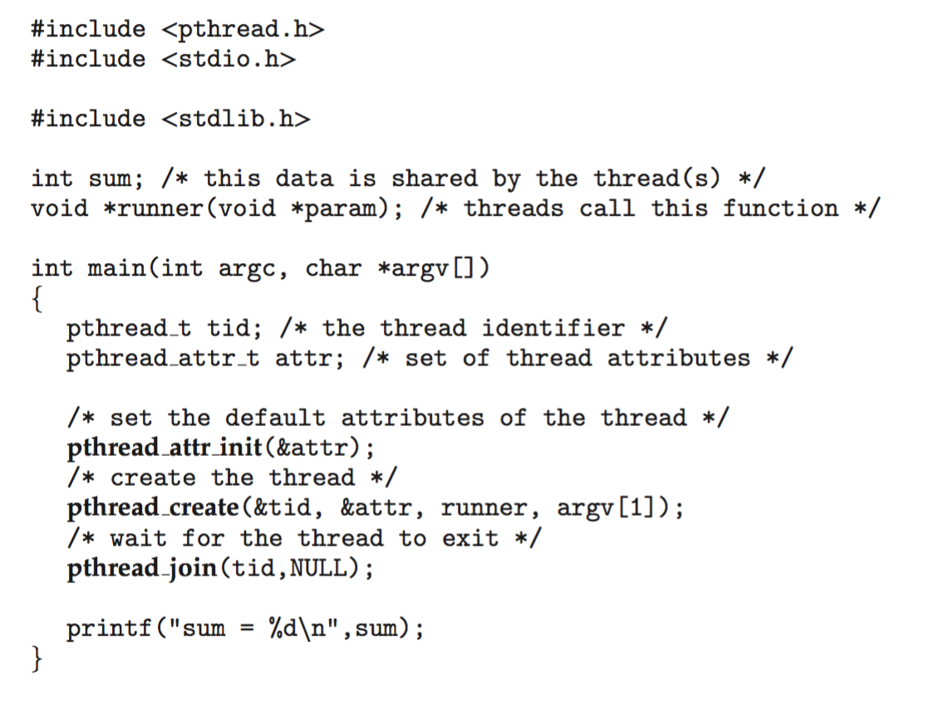
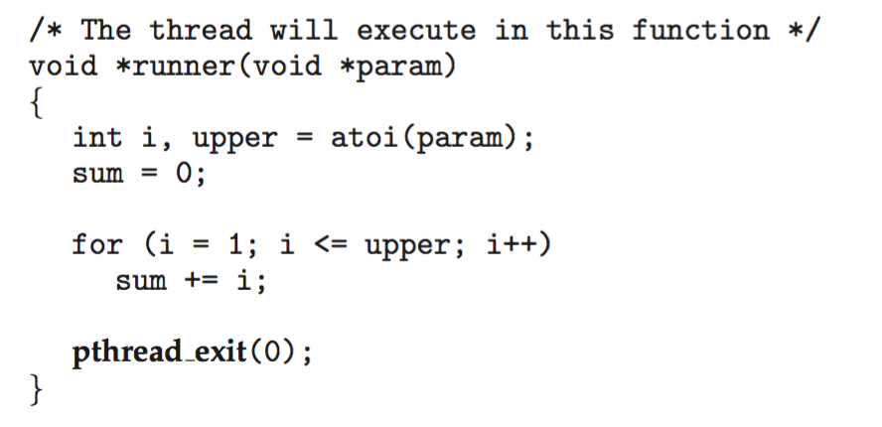
Pthreads
Notes:
Sum: It’s a global variable that will be accessible by both child and parent threads.
Signature of thread function: void *runner(void * param) [Must be exactly like this]
Void points can be anything and can be cast into anything like string, int, etc.
Every thread has an attribute, such as priority.
Runner will be executed when the thread is created.
atoi: String to integer
upper: Upper limit
Here we are creating 2 threads – Right(parent), Left(child)

Slide 20
Pthreads Code for Joining Ten Threads

Slide 21
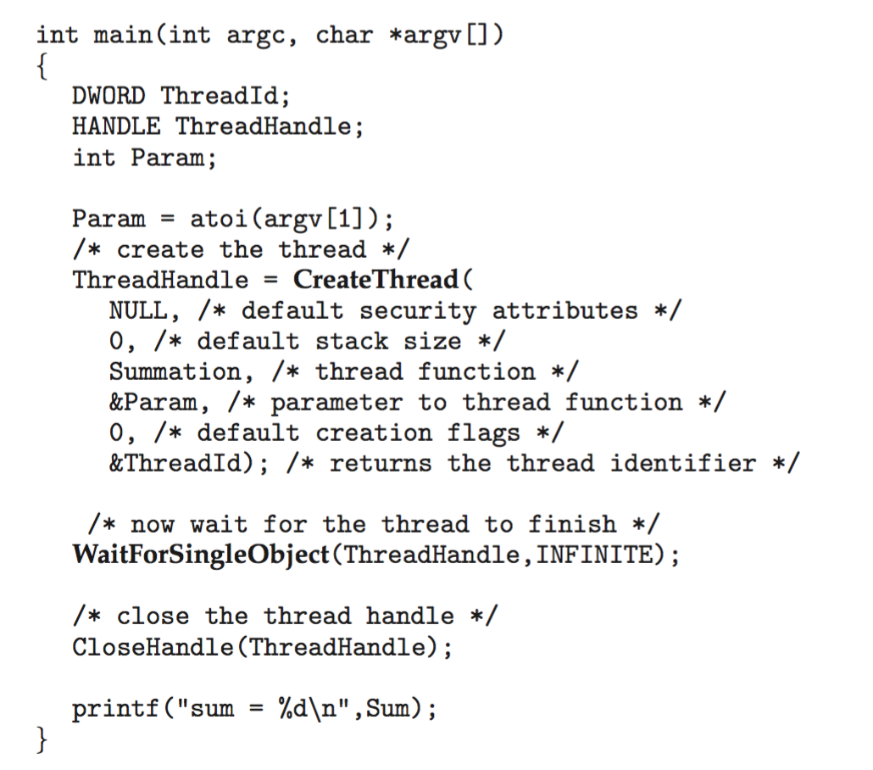
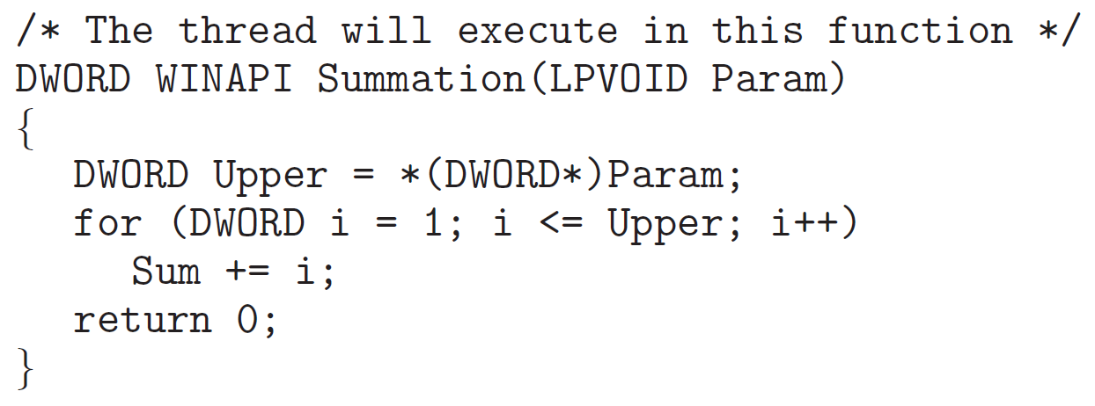
Windows Multithreaded C Program
DWORD – an unsigned 32-bit integer
LPVOID – a pointer to void
Notes:
DWORD: 32-byte integer (Double word)
HANDLE: It is also an integer.
LPVOID: Void pointer
*(DWORD*): This is de-referencing. Getting the value from that memory location.
Sum is a global variable (Its not there here but it should be)

Slide 22
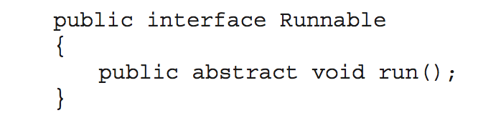
Java Threads
Java threads are managed by the JVM
Typically implemented using the threads model provided by underlying OS
Java threads may be created by:
Extending Thread class
Implementing the Runnable interface
Standard practice is to implement Runnable interface

Slide 23
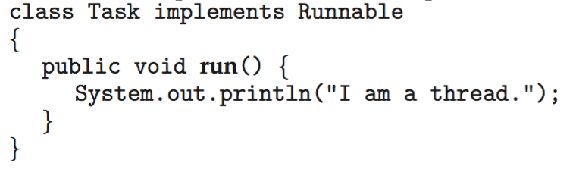
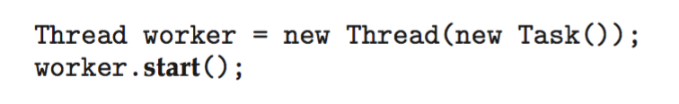
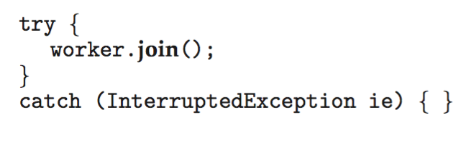
Java Threads
Implementing Runnable interface:
Creating a thread:
Waiting on a thread:
Notes:
Any task you want to execute must be done by runnable.
This is low-level threading to implement Java threads like this.
Driver.java

Slide 24
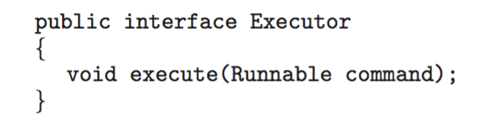
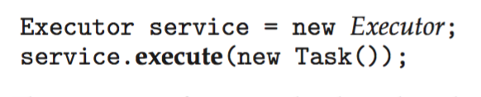
Java Executor Framework
Rather than explicitly creating threads, Java also allows thread creation around the Executor interface:
The Executor is used as follows:
Notes:
Previously, we were creating a thread explicitly, whereas here, those low-level stuff are done by the executor.

Slide 25
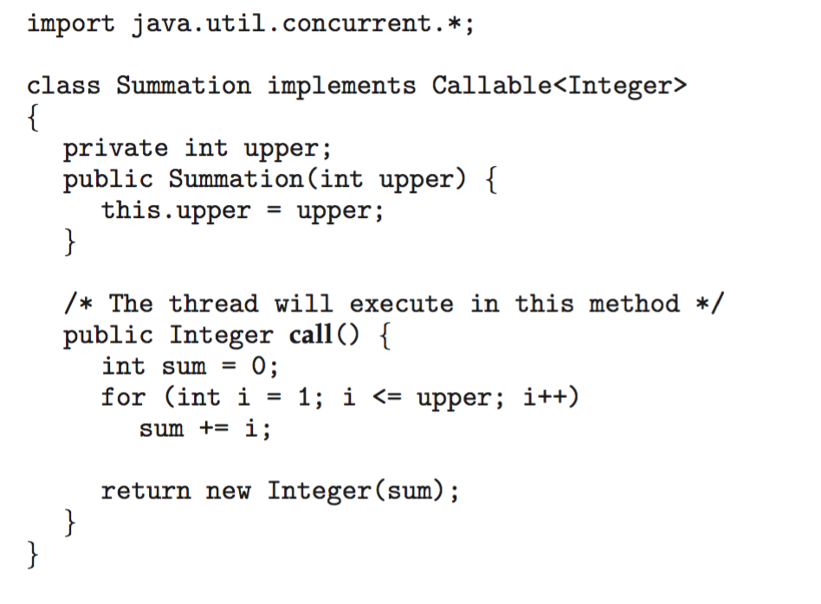
Java Executor Framework
Notes:
We cannot use a global variable to send the result from child to parent in Java.
Runnable can only execute the thread, if we want to return the value, we use callable.
Callable<Integer>: The return data is integer.

Slide 26
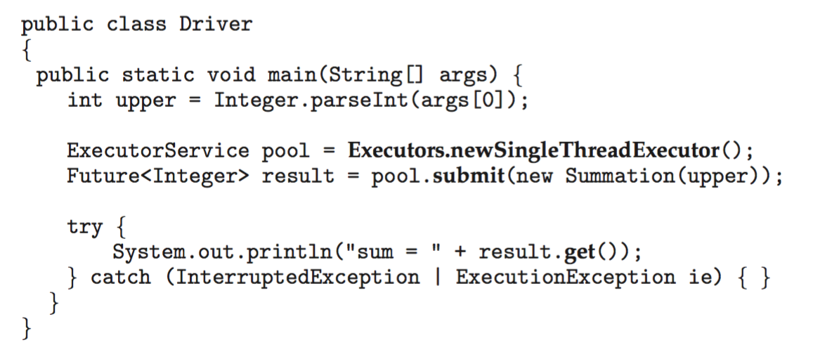
Java Executor Framework (contd.)
Notes:
Pool: Instance of the data structure.
Creating a system of pools where we have only one thread in the pool.
Once we have the pool we will submit the task.
Future<Integer>: The actual result we will be getting in the future, and we will get an integer.

Slide 27
Implicit Threading
Growing in popularity as numbers of threads increase, program correctness more difficult with explicit threads
Creation and management of threads done by compilers and run-time libraries rather than programmers
Advantage – only need to identify parallel tasks, and the libraries determine the specific details of thread creation and management.
Five methods explored
Thread Pools
Fork-Join
OpenMP
Grand Central Dispatch
Intel Threading Building Blocks
Notes:
It will create a pool, and the pool may contain more than 1 thread.
It will manage thread tasks(create, delete, etc.) automatically.
GCD: Used in Mac applications related to C programming.

Slide 28
Thread Pools
Create a number of threads in a pool where they await work
Advantages:
Usually slightly faster to service a request with an existing thread than create a new thread
Allows the number of threads in the application(s) to be bound to the size of the pool
Separating task to be performed from mechanics of creating task allows different strategies for running task
i.e., Tasks could be scheduled to run periodically

Slide 29
Java Thread Pools
Three factory methods for creating thread pools in Executors class:
static ExecutorService newSingleThreadExecutor()
static ExecutorService newFixedThreadPool(int size)
static ExecutorService newCachedThreadPool()
Notes:
newSingleThreadExecutor: Creating a pool with one thread.
newFixedThreadPool: Pass the number of threads in that pool.
newCachedThreadPool: The Pool will decide how many threads are required.

Slide 30
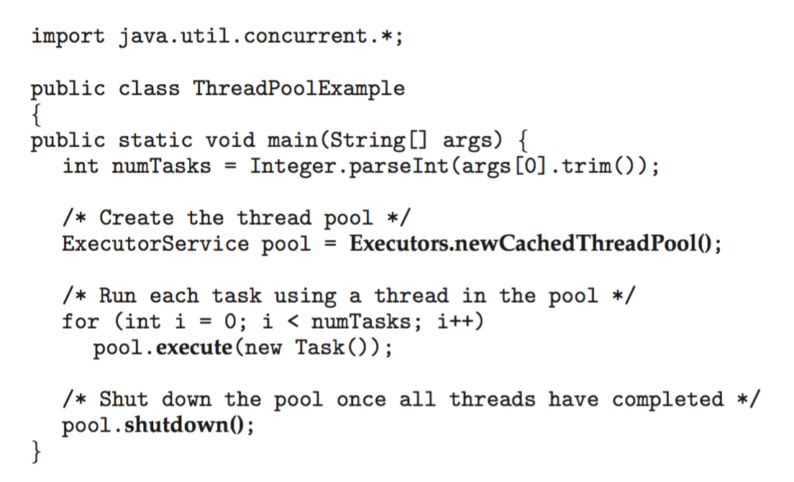
Java Thread Pools (Cont.)

Slide 31
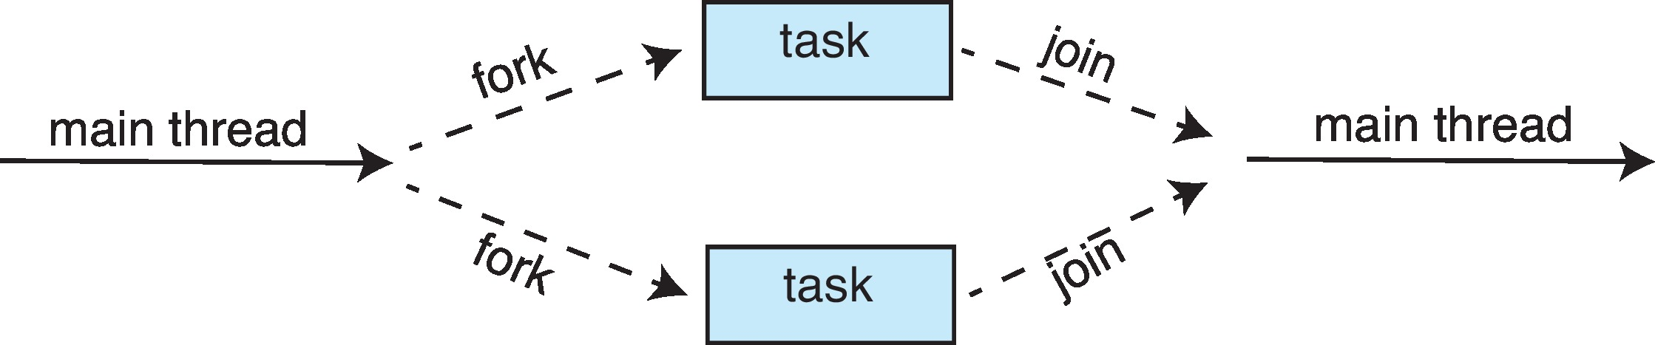
Fork-Join Parallelism
Multiple threads (tasks) are forked, and then joined.
Notes:
Fork: This means creating a separate thread or task.

Slide 32
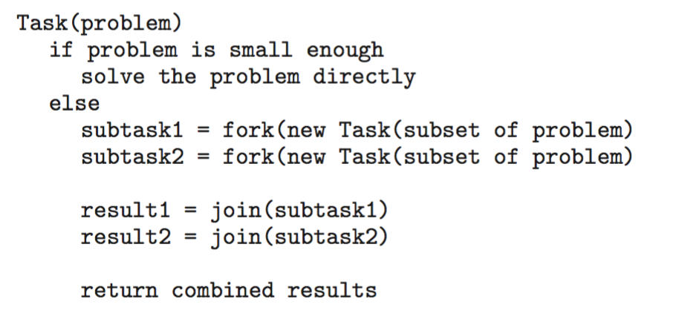
Fork-Join Parallelism
General algorithm for fork-join strategy:

Slide 33
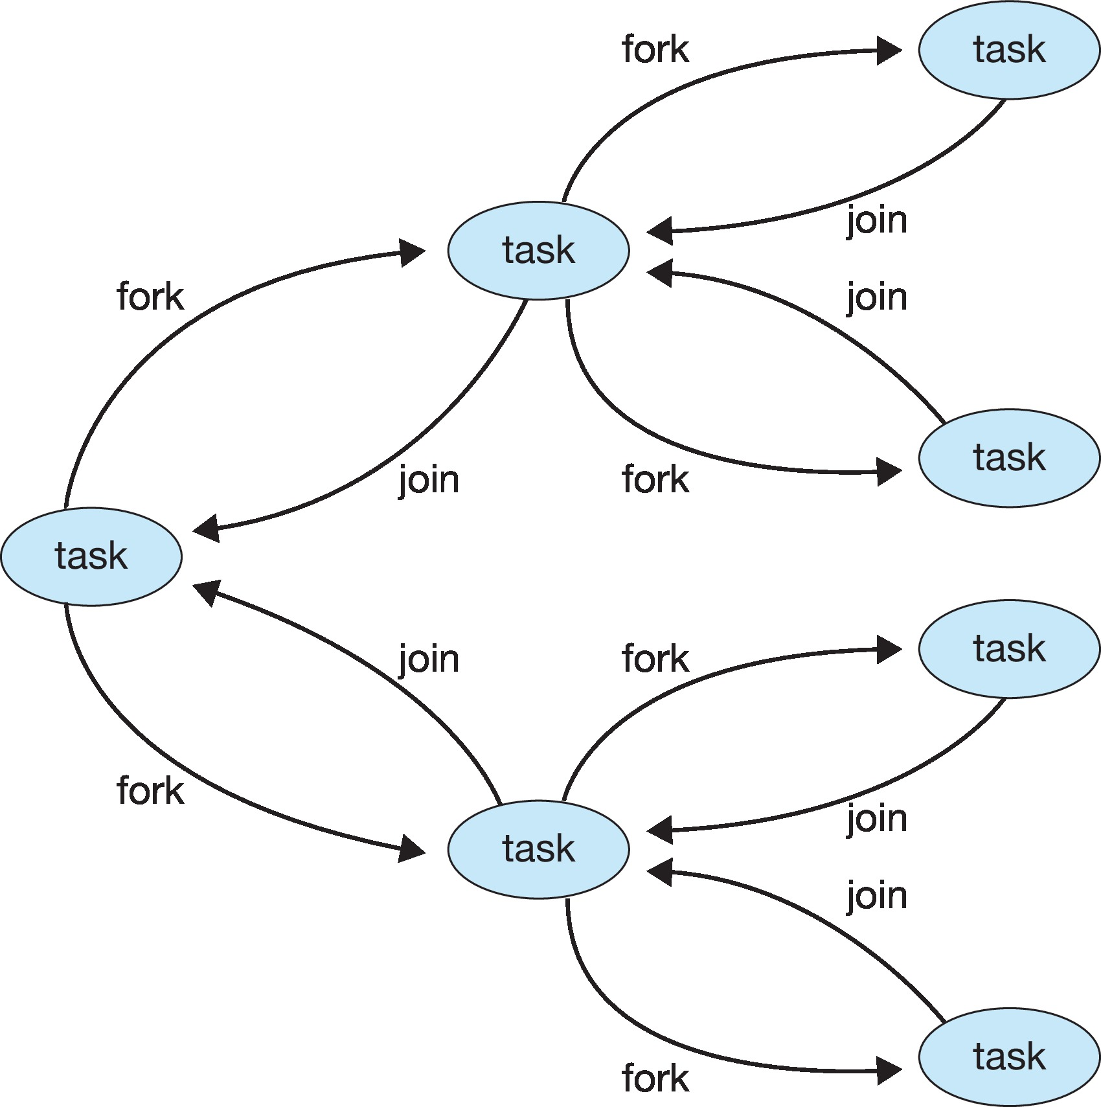
Fork-Join Parallelism

Slide 34
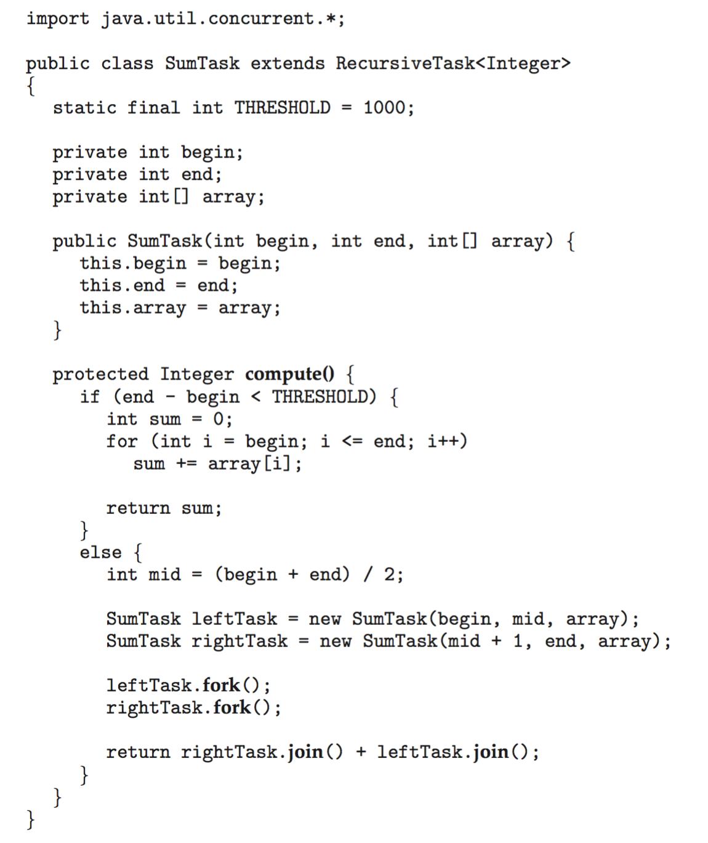
Fork-Join Parallelism in Java
Notes:
THRESHOLD: Detect whether the problem can be solved directly or not.

Slide 35
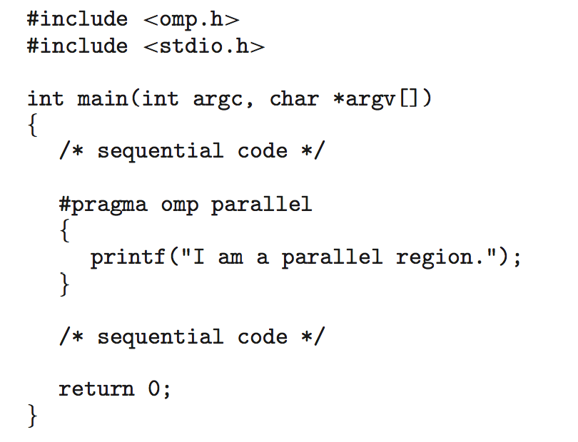
OpenMP
Set of compiler directives and an API for C, C++, FORTRAN
Provides support for parallel programming in shared-memory environments
Identifies parallel regions – blocks of code that can run in parallel
#pragma omp parallel
create as many threads as there are cores
Notes:
Open MP: Execute parallel programming without worrying about threads.
We need to tell them what to execute in parallel.
Code after the code will be executed in n-number of cores. How many threads will be created? → It depends on the processor.
If we have eight cores, → The code will executed eight times.

Slide 36
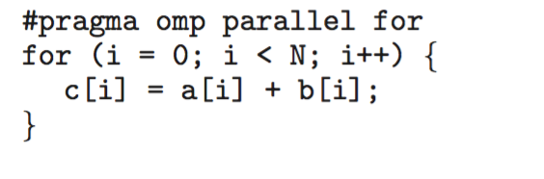
OpenMP for loop
Run the for loop in parallel
Notes:
There is no dependency. All the elements in c can be computed parallelly.

Slide 37
Grand Central Dispatch (GCD)
Apple technology for macOS and iOS operating systems
GCD: combination of extensions to C, C++ and Objective-C languages, API, and run-time library
Allows identification of parallel sections
Manages most of the details of threading
Block is in “^{ }” : ˆ{ printf("I am a block"); }
Blocks placed in dispatch queue
Assigned to available thread in thread pool when removed from queue
Notes:
The user should explicitly identify the block that can be executed parallelly and give it to GCD for execution.
Identify block → Get the queue → Put the block in the queue.

Slide 38
Grand Central Dispatch
Two types of dispatch queues:
serial – blocks removed in FIFO order, queue is per process, called main queue
Programmers can create additional serial queues within program
concurrent – removed in FIFO order but several may be removed at a time
Four system wide queues divided by quality of service:
QOS_CLASS_USER_INTERACTIVE
QOS_CLASS_USER_INITIATED
QOS_CLASS_USER_UTILITY
QOS_CLASS_USER_BACKGROUND
Notes:
Serial Queue: FIFO
Concurrent Queue: Remove in FIFO, but multiple blocks will be removed together, mimicking as if they will be executed in parallel.
INTERACTIVE: Execute as soon an possible.
UTILITY: Takes more time
BACKGROUND: Takes much more longer.

Slide 39
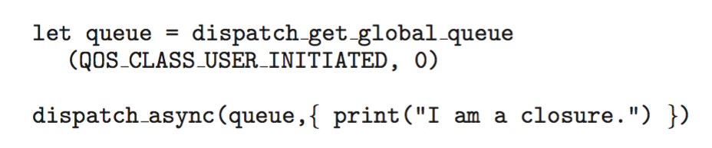
Grand Central Dispatch
For the Swift language a task is defined as a closure – similar to a block, minus the caret
Closures are submitted to the queue using the dispatch_async() function:
Notes:
Before invoking the dispatch function, we need to get the queue.
(This is a swift programming)

Slide 40
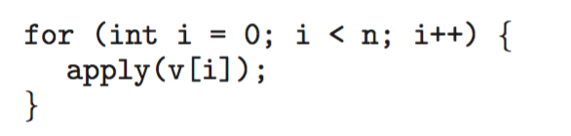
Intel Threading Building Blocks (TBB)
Template library for designing parallel C++ programs
A serial version of a simple for loop
The same for loop written using TBB with parallel_for statement:
Notes:
Purpose is the same, execute code parallelly without worrying about creating and destroying threads.
parallel_for( range, lambda function in cpp or anonymous function in java)
Apply() function is executed in different threads parallelly.

Slide 41
Threading Issues
Semantics of fork() and exec() system calls
Signal handling
Synchronous and asynchronous
Thread cancellation of target thread
Asynchronous or deferred
Thread-local storage
Scheduler Activations
Notes:
How fork and exec will be executed in multiple threads. Will the child replace the threads, or will the child keep the thread?
Synchronous: A signal is handled by the thread which created this signal.

Slide 42
Semantics of fork() and exec()
Does fork()duplicate only the calling thread or all threads?
Some UNIXes have two versions of fork
exec()usually works as normal – replace the running process including all threads
Which versions of the fork() to used depends on the application
If exec() is called immediately after forking, duplicate only the calling thread, why?
If the separate process does not call exec() after forking, duplicate all threads.
Notes:
Duplicate?: It depends on the situation.
Which version?: IMPORTANT statement. – If exec() is called immediately after forking, duplicate only the calling thread.
Why?: Because exec() will replace or delete the threads. So waste of creating.

Slide 43
Signal Handling
Signals are used in UNIX systems to notify a process that a particular event has occurred.
A signal handler is used to process signals
Signal is generated by particular event
Signal is delivered to a process
Signal is handled by one of two signal handlers:
default
user-defined
Every signal has default handler that kernel runs when handling signal
User-defined signal handler can override default
For single-threaded, signal delivered to process
Notes:
Signals: Some numbers that we can send from one process to another.
Control + C to kill the program because we don’t have any signal handler.

Slide 44
Signal Handling (Cont.)
Where should a signal be delivered for multi-threaded?
Deliver the signal to the thread to which the signal applies
Deliver the signal to every thread in the process
Deliver the signal to certain threads in the process
Assign a specific thread to receive all signals for the process
The standard UNIX function for delivering a signal
kill (pid_t pid, int signal)
Signal to POSIX Pthreads
pthread_kill(pthread_t tid, int signal)
Notes:
Kill() in UNIX: Send the signal from one process to another. Send a signal to particular PID.
Pthread_kill(): Send the signal to another process.

Slide 45
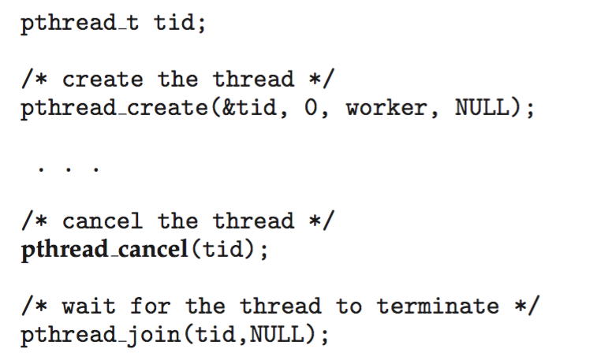
Thread Cancellation
Terminating a thread before it has finished
Thread to be canceled is target thread
Two general approaches:
Asynchronous cancellation terminates the target thread immediately
Deferred cancellation allows the target thread to periodically check if it should be cancelled
Pthread code to create and cancel a thread:
Notes:
Will the thread be canceled immediately?
Asynchronous cancellation: The thread will be destroyed immediately.
Deferred cancellation: Check whether the thread was canceled or not previously. It is written Boolean.
Pthread_create(&tid, 0, worker, null): the worker is a function that has a null parameter, which will be executed when the thread is created.

Slide 46
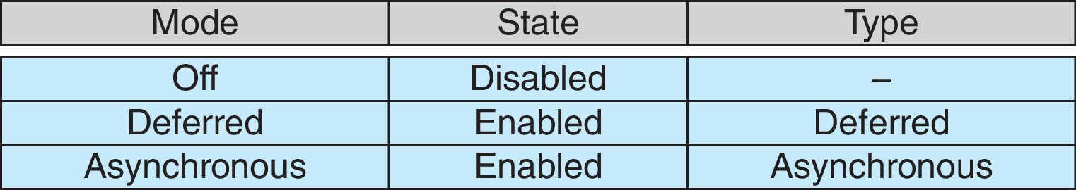
Thread Cancellation (contd.)
Invoking thread cancellation requests cancellation, but actual cancellation depends on thread state
If thread has cancellation disabled, cancellation remains pending until thread enables it
Default type is deferred
Cancellation only occurs when thread reaches cancellation point
i.e., pthread_testcancel()
Then cleanup handler is invoked
On Linux systems, thread cancellation is handled through signals
Notes:
Create modes for a thread. We can turn on or off the cancellation mode.
Mode off: We cannot delete the thread even if we call the method.
pthread_testcancel() → Returns Boolean.

Slide 47
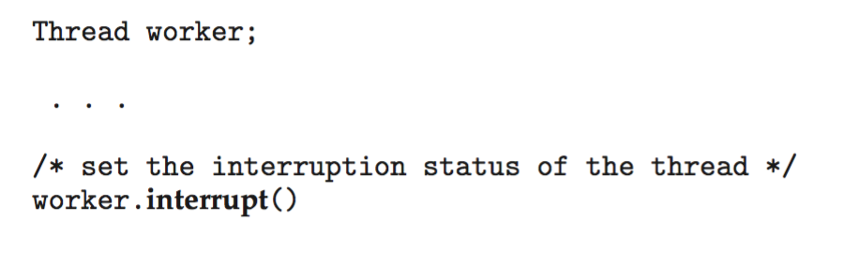
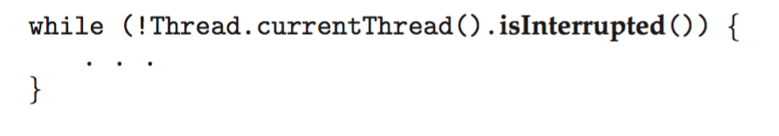
Thread Cancellation in Java
Deferred cancellation uses the interrupt() method, which sets the interrupted status of a thread.
A thread can then check to see if it has been interrupted:

Slide 48
Thread-Local Storage
Thread-local storage (TLS) allows each thread to have its own copy of data
Useful when you do not have control over the thread creation process (i.e., when using a thread pool)
Different from local variables
Local variables visible only during single function invocation
TLS visible across function invocations
Similar to static data
TLS is unique to each thread
Notes:
We need to be careful about this in the multi-threaded process.
What about local variables?
Each thread will have a local storage that is global inside that thread.

Slide 49
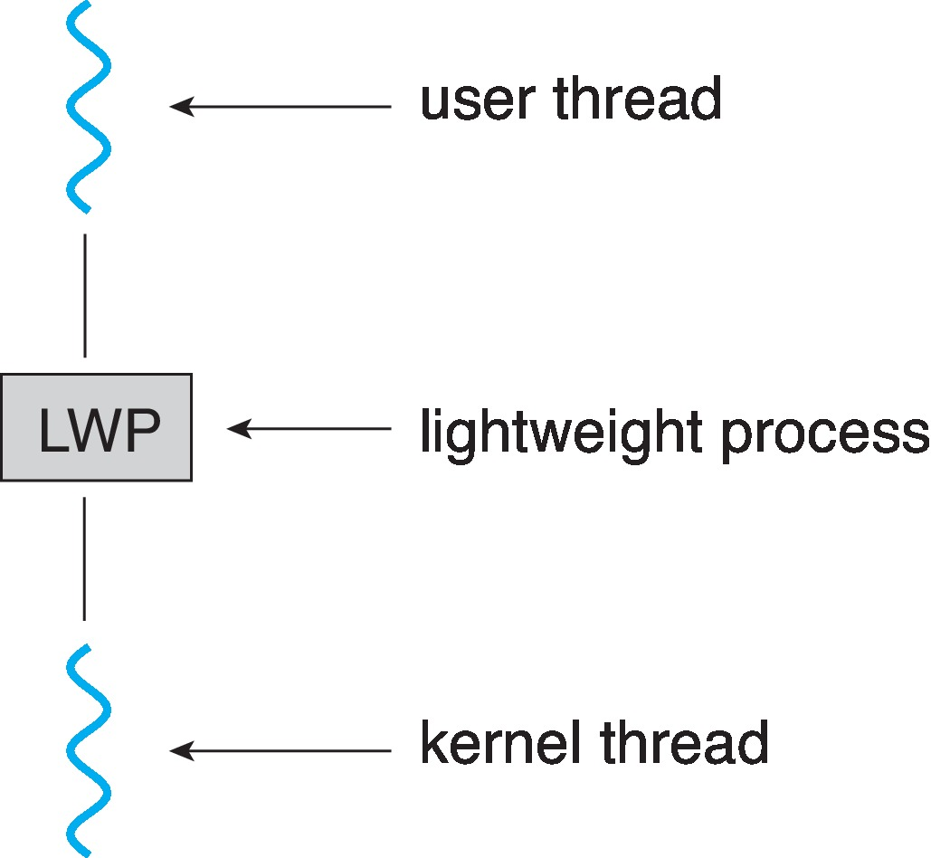
Scheduler Activations
Both Many-to-Many and Two-level models require communication to maintain the appropriate number of kernel threads allocated to the application
Typically use an intermediate data structure between user and kernel threads – lightweight process (LWP)
Appears to be a virtual processor on which a process can schedule user thread to run
Each LWP attached to kernel thread
How many LWPs to create?
Scheduler activations provide upcalls - a communication mechanism from the kernel to the upcall handler in the thread library
Notes:
How the mapping is done and efficiently executed is the main question.
LWP: Data structure.
Whenever we create a new thread there will be LWP created.
If we have 5 kernel threads, we will have 5 LWP.
The information is stored in LWP, and the OS will take data from LWP.
Switching between threads in user space is easier that kernel space.
If kernel thread is about to block, it will send a message/information to LWP. Then that LWP is blocked and a new thread is created. The information is passes up from kernel thread to LWP.
And the thread is switched in user thread instead of kernel space.

Slide 50
Operating System Examples
Windows Threads
Linux Threads

Slide 51
Windows Threads
Windows API – primary API for Windows applications
Implements the one-to-one mapping, kernel-level
Each thread contains
A thread id
Register set representing state of processor
Separate user and kernel stacks for when thread runs in user mode or kernel mode
Private data storage area used by run-time libraries and dynamic link libraries (DLLs)
The register set, stacks, and private storage area are known as the context of the thread

Slide 52
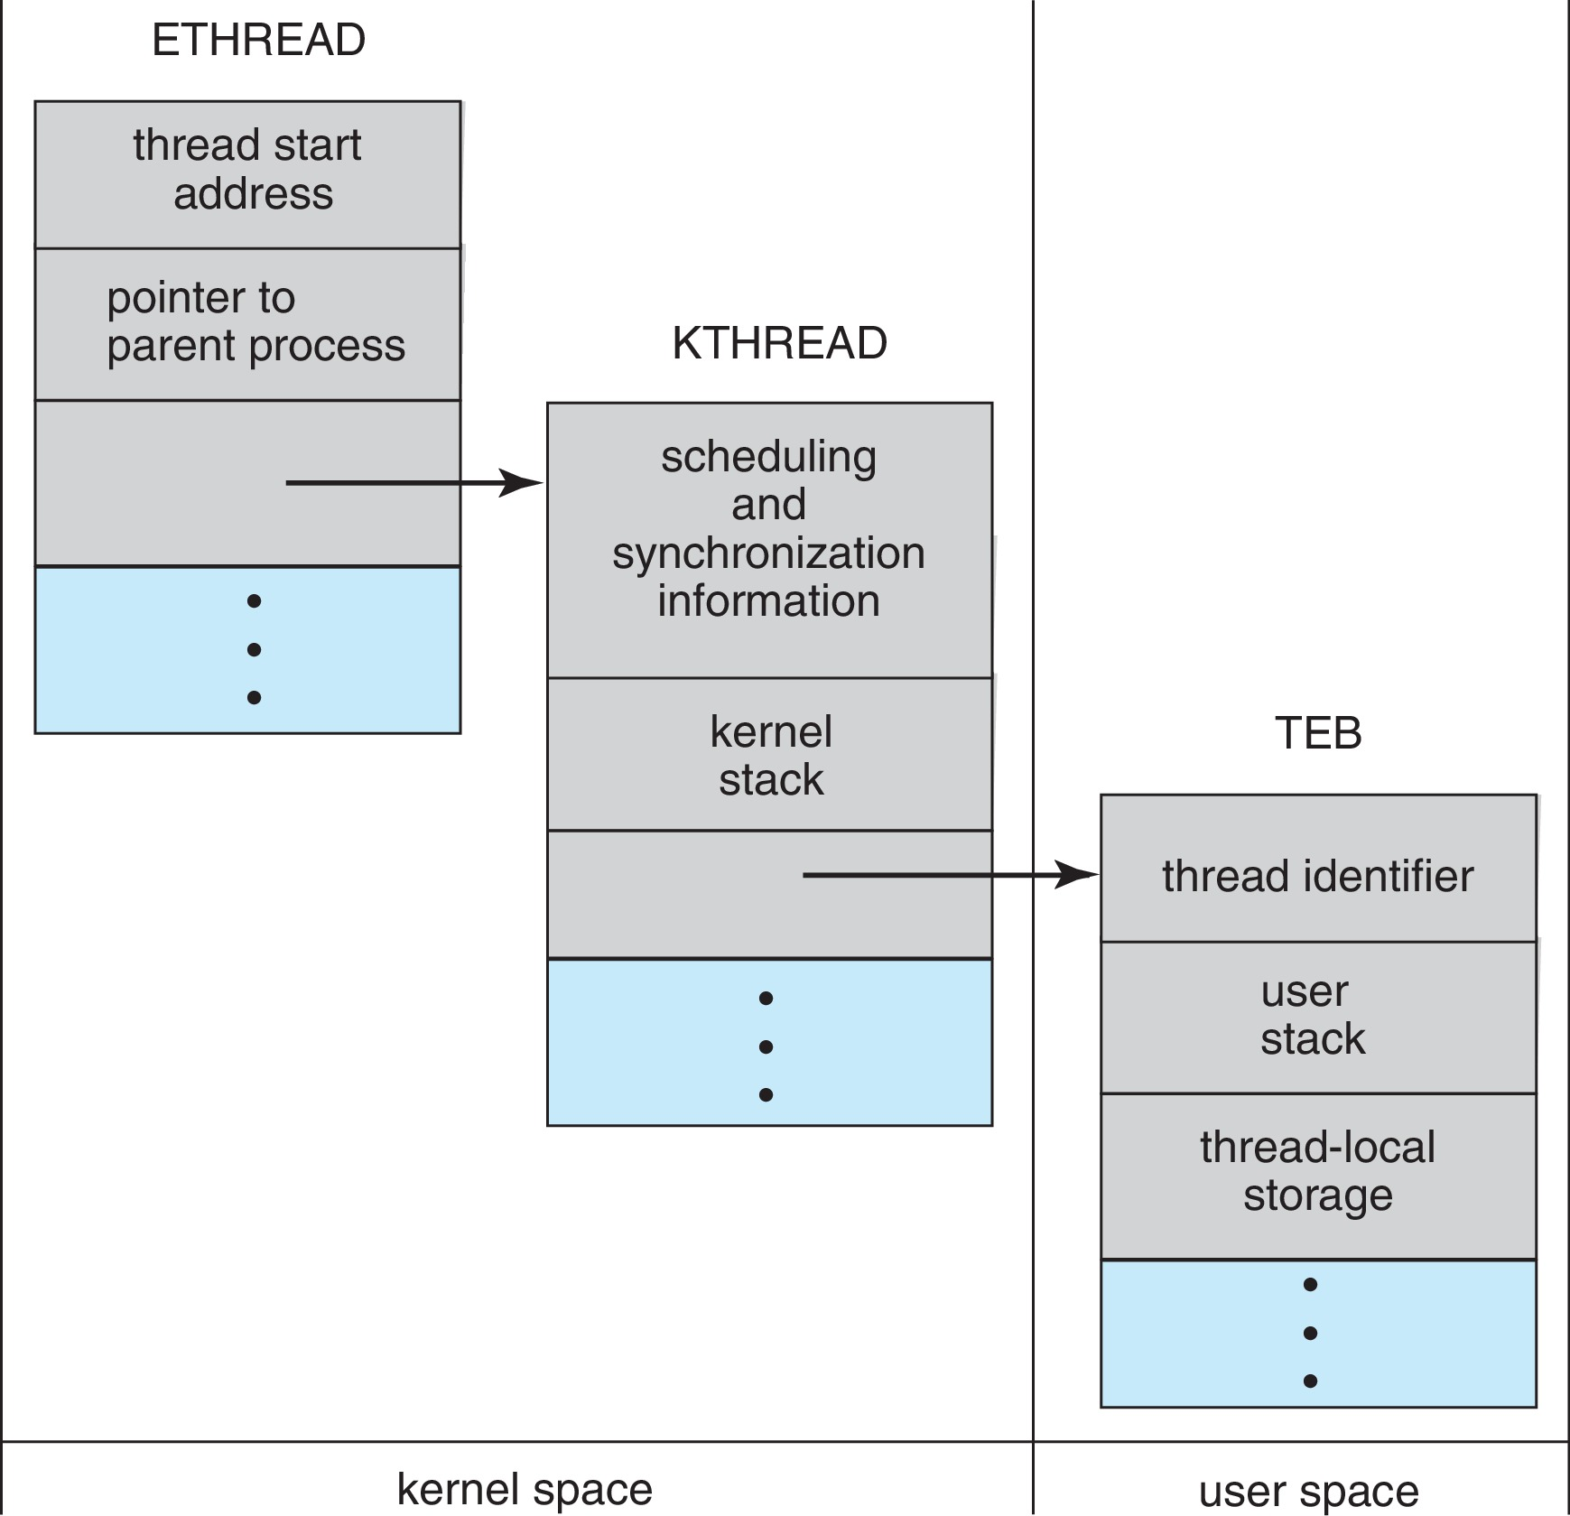
Windows Threads Data Structures
Notes:
3 Data Structures:
ETHREAD—executive thread block
KTHREAD—kernel thread block
TEB—thread environment block

Slide 53
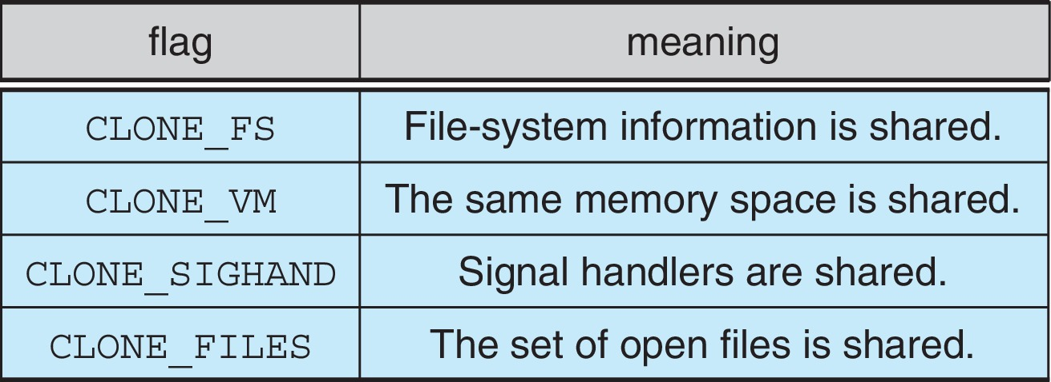
Linux Threads
Linux refers to them as tasks rather than threads
Thread creation is done through clone() system call
clone() allows a child task to share the address space of the parent task (process)
Flags control behavior
struct task_struct points to process data structures (shared or unique)
Notes:
Clone() will create a thread, and fork() will create a process.
Shared between the parent and child.
Task_struct: Contains thread information in Linux.

